Slide 1
What Is a Java Program?

Slide 2

Objectives
After completing this lesson, you should be able to:
  Contrast the terms “platform-dependent” and “platform-independent”
  Describe the purpose of the JVM
  Explain the difference between a procedural program and an object-oriented program
  Describe the purpose of javac and java executables
  Verify the Java version on your system
  Run a Java program from the command line
Notes:
Java SE 8 Fundamentals 2 - <number>

Slide 3
Topics
  Introduction to computer programs
  Introduction to the Java language
  Verifying the Java development environments
  Running and testing a Java program
Notes:
Java SE 8 Fundamentals 2 - <number>

Slide 4



Purpose of a Computer Program
A computer program is a set of instructions that run on a computer or other digital device.
  At the machine level, the program consists of binary instructions (1s and 0s).
    Machine code
  Most programs are written in high-level code (readable).
    Must be translated to machine code
Notes:
Java SE 8 Fundamentals 2 - <number>

Slide 5


Translating High-Level Code to Machine Code
Solaris OS
C Compiler
Solaris OS Binary
Linux
C Compiler
C Code
Linux Binary
Microsoft Windows
C Compiler
Microsoft Windows Binary
Notes:
Programs written in most languages usually require numerous modifications to run on more than one type of computing platform, (a combination of a CPU and operating system). This platform-dependence is because most languages require you to write code specific to the underlying platform. Popular programming languages, such as C and C++, require programmers to compile and link their programs, resulting in an executable program unique to a platform. A compiler is an application that converts a program that you write into a CPU-specific code called machine code. These platform-specific files (binary files) are often combined with other files, such as libraries of prewritten code, using a linker to create a platform-dependent program, called an executable, which can be executed by an end user. Unlike C and C++, the Java programming language is platform-independent.
The image illustrates how a compiler creates a binary file.
Java SE 8 Fundamentals 2 - <number>

Slide 6

Linked to Platform-Specific Libraries
Project Libraries
Solaris OS
C Compiler
Solaris OS Binary
Solaris OS Executable
Project Libraries
Linux
C Compiler
Linux Binary
Linux Executable
Project Libraries
Microsoft Windows
C Compiler
Microsoft Windows Binary
Microsoft Windows Executable
Notes:
The image illustrates how a binary file is linked with libraries to create a platform-dependent executable.
Java SE 8 Fundamentals 2 - <number>

Slide 7


Platform-Dependent Programs
Solaris OS Workstation
Solaris OS Executable
Linux Executable
Linux Workstation
Microsoft Windows Executable
Microsoft Windows Workstation
Notes:
The image illustrates how platform-dependent executables can execute only on one platform.
Java SE 8 Fundamentals 2 - <number>

Slide 8
Topics
  Introduction to computer programs
  Introduction to the Java language
  Verifying the Java development environment
  Running and testing a Java program
Notes:
Java SE 8 Fundamentals 2 - <number>

Slide 9
Key Features of the Java Language
Some of the features that set Java apart from most other languages are that:
  It is platform-independent
  It is object-oriented
Notes:
There are several other key features of the Java language, but in this course, only the two mentioned above will be discussed.
Java SE 8 Fundamentals 2 - <number>

Slide 10
Java Is Platform-Independent
Project Libraries
Java Compiler
Java Code
Java Bytecode
Notes:
A Java program can run on several different CPUs and operating system combinations, such as the Solaris OS on a SPARC chip, Mac OS X on an Intel chip, and Microsoft Windows on an Intel chip, usually with few or no modifications.
As illustrated above, Java programs are compiled using a Java compiler. The resulting format of a compiled Java program is platform-independent Java bytecode instead of CPU-specific machine code.
After the bytecode is created, it is interpreted by a bytecode interpreter called the Java Virtual Machine or JVM. A virtual machine is a platform-specific program that understands platform-independent bytecode and can execute it on a particular platform. For this reason, the Java programming language is often referred to as an interpreted language, and Java technology programs are said to be portable or executable on any platform. Other interpreted languages include Perl.
Java SE 8 Fundamentals 2 - <number>

Slide 11
Java Programs Run In a Java Virtual Machine
JRE
Solaris OS Workstation
Java Bytecode
(.class file)
JRE
Linux Workstation
JRE
Java Virtual
Machine
(JVM)
Microsoft Windows Workstation
Notes:
The image illustrates a Java bytecode file executing on several platforms where a Java runtime environment exists.
A virtual machine gets its name because it is a piece of software that runs code, a task usually accomplished by the CPU or hardware machine. For Java programs to be platform-independent, a virtual machine called the JVM is required on every platform where your program will run. The JVM is responsible for interpreting Java code, loading Java classes, and executing Java programs.
However, a Java program needs more than just a JVM to execute. A Java program also needs a set of standard Java class libraries for the platform. Java class libraries are libraries of prewritten code that can be combined with the code that you write to create robust applications.
Combined, the JVM software and Java class libraries are referred to as the Java Runtime Environment (JRE). Java Runtime Environments are available from Oracle for many common platforms.
Java SE 8 Fundamentals 2 - <number>

Slide 12
Procedural Programming Languages
  Many early programming languages
  followed a paradigm called Procedural
  Programming.
  These languages use a sequential
  pattern of program execution.
  Drawbacks to procedural programming:
    Difficult to translate real-world use cases
    to a sequential pattern
    Difficult to maintain programs
    Difficult to enhance as needed
1
Step 1
2
Step 2
3
Step 3
4
Step 4
5
Step 5
Notes:
Earlier programming languages were based on a programming paradigm called “procedural”. Procedural languages use a sequential pattern of program execution such as you see in the diagram above. Some examples of procedural programming languages are COBOL, Fortran, C, and Pascal.
This style of programming has become less popular due to the difficulty of designing real-world applications using sequential pattern. It has also proven difficult to maintain and enhance programs structured in this way.
Java SE 8 Fundamentals 2 - <number>

Slide 13
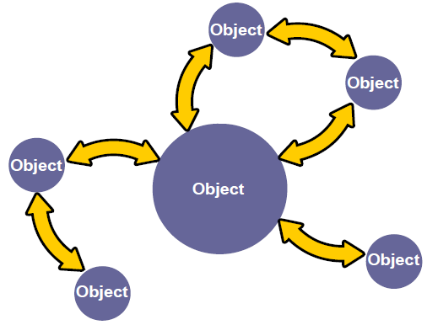
Java Is an Object-Oriented Language
  Interaction of objects
  No prescribed sequence
  Benefits:
    Modularity
    Information hiding
    Code reuse
    Maintainability
Notes:
Object-oriented programming differs from procedural programming, because procedural programming stresses the sequence of coding steps required to solve a problem, whereas object-oriented programming stresses the interaction of objects. Java is an object-oriented programming (OO) language. One of the main goals of an OO language is to create objects—pieces of autonomous code—that can interact with other objects to solve a problem. OO programming languages began in 1967 and have led to popular programming languages such as C++, upon which Java is loosely based.
This provides many benefits:
Modularity: The source code for an object can be written and maintained independently of the source code for other objects. After it is created, an object can be easily passed around inside the system.
Information hiding: By interacting only with an object’s methods, the details of its internal implementation remain hidden from the outside world.
Code reuse: If an object already exists (perhaps written by another software developer), you can use that object in your program.
Maintainability: If a particular object is found to be problematic, you can create another, slightly modified one and simply replace the original one in your application. This is analogous to fixing mechanical problems in the real world. If a bolt breaks, you replace the bolt, not the entire machine.
The diagram illustrates an object-oriented program’s focus on objects and object interactions.
Java SE 8 Fundamentals 2 - <number>

Slide 14
Topics
  Introduction to computer programs
  Introduction to the Java language
  Verifying the Java development environment
  Running and testing a Java program
Notes:
Java SE 8 Fundamentals 2 - <number>

Slide 15
Verifying the Java Development Environment
  Download and install the Java Development Kit (JDK) from oracle.com/java.
  Explore the Java Help menu.
  Compile and run a Java application by using the command line.
Notes:
Setting up your Java development environment is a simple task. The JDK is available for free from the Oracle Java website.
After you have installed the JDK, you can explore the Java environment by typing some commands at the command line. For example, open a terminal window and enter java.
Review the command options displayed.
Enter java –version to see what Java version is installed on your system.
Compile and run a Java application using the command line.
Java SE 8 Fundamentals 2 - <number>

Slide 16
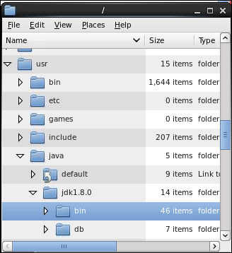
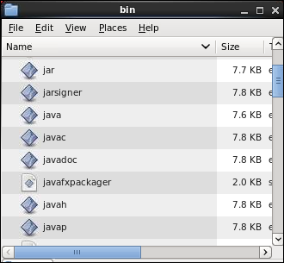
Examining the Installed JDK (Linux Example):
The Tools
Runtime
Compiler
PATH points here
Notes:
Java SE (Standard Edition) Development Kit
The Java SE Development Kit includes both the tools and classes that you will use to develop a Java program. The tools and utilities are stored in the bin directory. These are shown in the screenshot on the right. They include:
A Java Virtual Machine (JVM) for the platform you choose. Here you see a Linux example. The runtime engine is started by running the java program.
A Java compiler, started by running the javac program
Additional utilities, such as utilities for creating Java archive files (JAR files) and for debugging Java programs
The bin directory, which must be on the system PATH in order to run or compile a Java program. The Java installer automatically adds the bin to your system PATH.
Note: The Java Runtime Environment used in production (commonly called the JRE) is also included with Java SE Development Kit. This is found in the jre directory.
Java SE 8 Fundamentals 2 - <number>

Slide 17
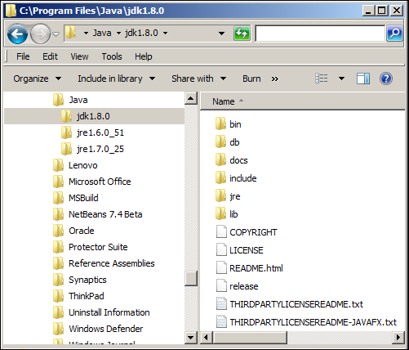
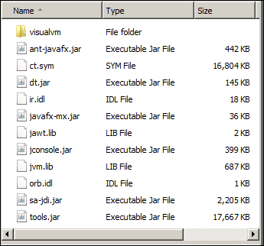
Examining the Installed JDK (Windows Example):
The Libraries
Notes:
Java SE Development Kit
In addition to the executable files found in the bin directory of the JDK, various class libraries are installed that conform to the particular platform that you chose. Here you see a Windows example. The core libraries are found in the lib directory as shown above.
The Java runtime engine requires these libraries.
In addition to the Java SDK download, other items are available as a separate download, such as the Java class library (API) documentation and the Java Language Specification.
Java SE 8 Fundamentals 2 - <number>

Slide 18
Topics
  Introduction to computer programs
  Introduction to the Java language
  Verifying the Java development environment
  Running and testing a Java program
Notes:
Java SE 8 Fundamentals 2 - <number>

Slide 19
Compiling and Running a Java Program
The source code is contained in a .java file.
The source code is compiled by javac.
The result is a .class file (bytecode).
The class file is executed by the java runtime.
.java
javac
.class
java
Notes:
The diagram above shows what happens when you compile and run a Java program.
The Java code is written in a file with the extension .java. This is called the “Java source code.”
You use the javac executable to compile the source code (the “c” stands for “compiler”) into a bytecode file with the extension .class. This is called a Java class.
You use the java executable to run the Java class. This is your Java program.
Java SE 8 Fundamentals 2 - <number>

Slide 20
Compiling a Program
  Go to the directory where the source code files are stored.
  Enter the following command for each .java file you want to compile.
  Syntax:
  javac SayHello.java
  Example:
  javac SayHello.java
Notes:
Compiling converts the source files that you write into bytecode that can be executed by a Java Virtual Machine. The source file has a .java extension. It also defines a public class of the same name. For example, the class, SayHello, must be saved in a file called SayHello.java. (You learn more about classes later in this course.)
To compile the SayHello source code, perform the following steps:
1. Go to the directory where the source code files are stored.
2. Enter the following command for each .java file that you want to compile (Note that the .java extension is required.):
Example: javac SayHello.java
After the compilation has finished, and assuming no compilation errors have occurred, you should have a new file called <classname>.class in your directory for each source code file that you compiled.
Example: SayHello.class
Java SE 8 Fundamentals 2 - <number>

Slide 21
Executing (Testing) a Program
  Go to the directory where the class files are stored.
  Enter the following for the class file that contains the main method:
  Syntax:
java <classname>
  Example:
java SayHello
  Output:
Hello World!
Do not specify .class.
Notes:
When you have successfully compiled your source code files, you can execute and test them using the Java Virtual Machine.
To execute and test your program:
1. Go to the directory where the class files are stored.
Enter the following command for the class file that contains the main method. Note that here the file extension (.class) should not be included.
Example: java SayHello
This command runs the SayHello class. The SayHello class contains the main method. This is the entry point to a Java application. The java executable only works with a class containing a main method. In the above example, the main method contains code that prints the string "Hello World!”.
Java SE 8 Fundamentals 2 - <number>

Slide 22
Output for a Java Program
A Java program can output data in many ways. Here are some examples:
  To a file or database
  To the console
  To a webpage or other user interface
Notes:
In this course, we will be outputting data only to the console. You can learn more about writing to other destinations, such as a file, database, or webpage, by taking the Java SE 8 Programming course.
Java SE 8 Fundamentals 2 - <number>

Slide 23
Exercise 2-1
  From a Terminal window, enter java –version to see the system’s Java version.
  Look for SayHello.java in:
    /labs/02-GettingStarted/Exercises/Exercise1
  Compile it: javac SayHello.java
  Run the resulting class file: java SayHello
      Did you see the output?
Notes:
In this exercise, you look at the Java version installed on your system, and then you run a simple Java program from the command line.
Open a terminal window by double-clicking the Terminal shortcut on your desktop. It will open at your home directory, which is /home/oracle.
Note: A handy shortcut to navigate to your home directory from anywhere is ~. Example: cd ~ to go to /home/oracle.
Enter java to see the available command options.
Enter java -version to verify that JDK 1.8.0 is installed on your system.
Navigate to the folder containing the Java source file for this exercise:
cd labs/02-GettingStarted/Exercises/Exercise1
Enter javac SayHello.java to compile it.
Enter java SayHello to run it. You should see a “Hello World!” message as output.
Java SE 8 Fundamentals 2 - <number>

Slide 24
Quiz
Which of the following is correct? (Choose all that apply.)
  javac OrderClass
  java OrderClass
  javac OrderClass.java
  java OrderClass.java
Notes:
Answer: b, c
The .java extension is needed only when you compile a class (using javac).
Java SE 8 Fundamentals 2 - <number>

Slide 25
Summary
In this lesson, you should have learned how to:
  Describe the distinction between high-level language and machine code
  Describe what platform-independence means
  Describe how a Java program is compiled and to what format
  Explain what it means to say that Java is an object-oriented language
  Determine the version number of a Java install
  Use the javac tool to compile Java source code and the java tool to run or test your program
Notes:
Java SE 8 Fundamentals 2 - <number>

